Slide 1
CHARACTER RECOGNITION

Slide 2
MEMBERS
Đỗ Minh Duy - ITITSB22029
Trần Anh Văn - ITITSB22017
Nguyễn Đặng Thành Vinh - EEACIU22204
Nguyễn Ngọc Tài - EEACIU22196
Bùi Văn Tiến Đạt - ITITWE20005

Slide 3
TABLE OF CONTENTS
01 | The Project 02 | What is Character Recognition 03 | Effect of Character Recognition 04 | Benefts of Character Recognition 05 | Code

Slide 4
1. The project (Character Recognition)
Create a GUI
Allow to load an image (vehicle’s license plate with digits in clear condition, i.e. 51A-123.45)
Print the digits one-by-one in a single row (i.e. 5 1 A 1 2 3 4 5)

Slide 5
2. What is Character Recognition
Character recognition (CR) is converting an image of text into a machine-readable text format.
For example, if you scan a form or receipt, your computer will save that scan as an image file.

Slide 6
3. Effect of Character Recognition
Character Recognition digitizes paper documents, reducing the need for physical storage.
Text data recognized from digitized documents can be used to automate business processes.
Data from digitized documents can be analyzed to extract key information, detect trends.
Using Character Recognition reduces the time and effort required to process paper documents.

Slide 7
4. Benefit of Character Recognition
In banking, Character Recognition is used to improve document verification and prevent fraud.
In healthcare, Character Recognition helps manage patient records and insurance payments efficiently.
In logistics management, Character Recognition is used to track and manage documents such as packaging labels and invoices.
Specific examples include BlueVine, nib Group, and Foresight Group, demonstrating its practical application in these industries.

Slide 8
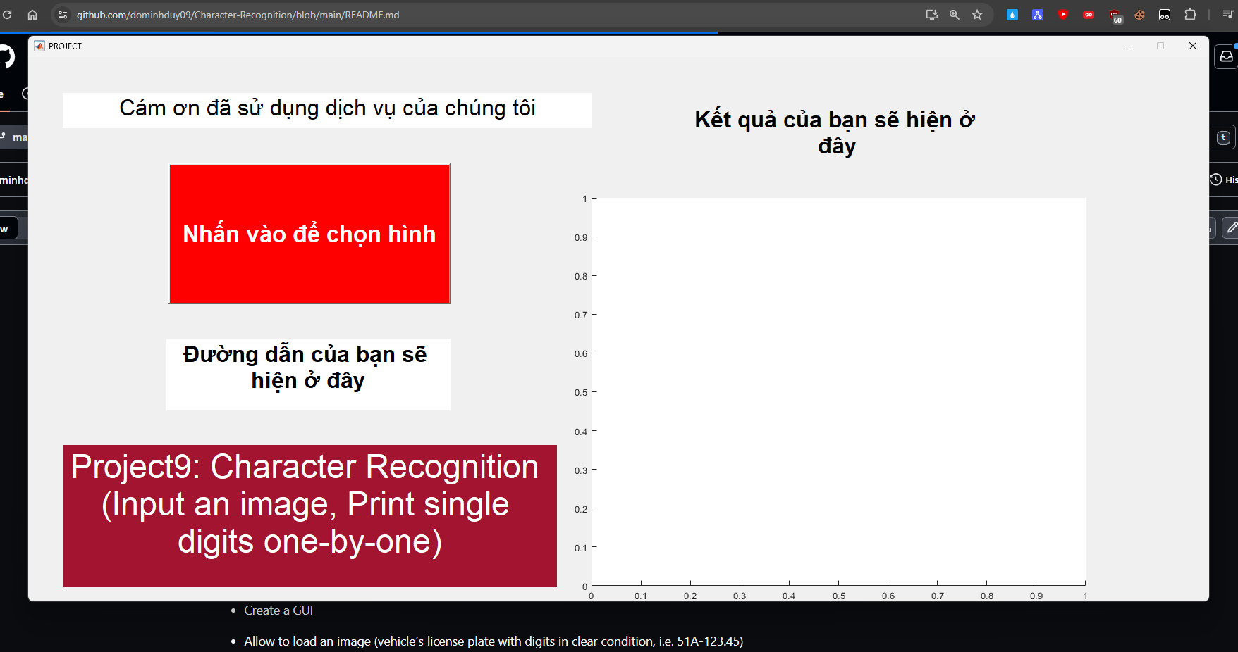
5.Introduction to Code
This is code
https://github.com/dominhduy09/Character-Recognition/blob/main/PROJECT.m#L1

Slide 9
THANK YOU FOR LISTENING!

